Slide 1


An introduction to
Lecture-3
Sharun Akter Khushbu
Lecturer (Senior Scale)
Department of Computer Science and Engineering

Slide 2

What is
Hadoop is an open project overseen by the Apache Software Foundation
Originally based on papers published by Google in 2003 and 2004
Hadoop committers work at several different organizations – Including Cloudera, Yahoo!, Facebook, LinkedIn
Hadoop takes a radical new approach to the problem of distributed computing – distribute the data as it’s initially stored in the system and individual nodes work on data local to the nodes.

Slide 3
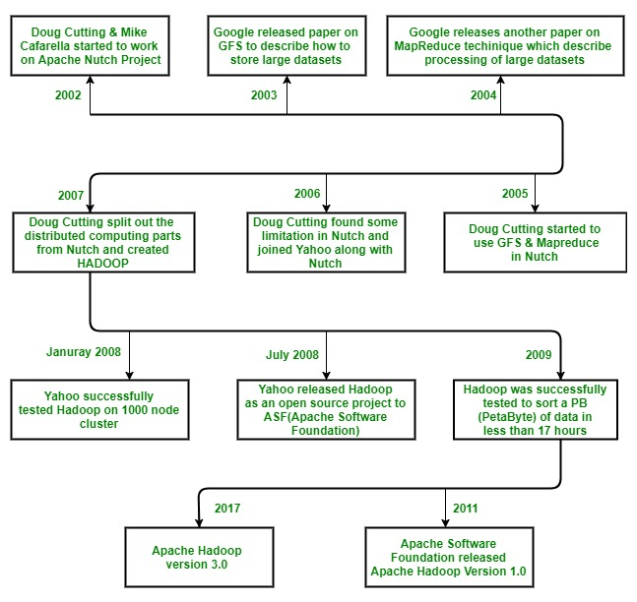
History

Slide 4

Who Uses Hadoop?

Slide 5
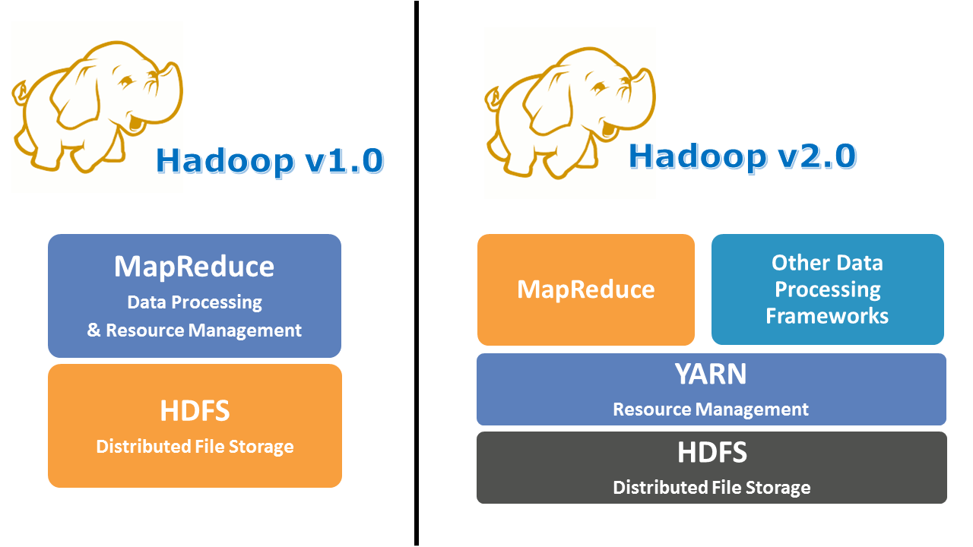
Hadoop Components
Application
& Resource Management
Layer
Application Layer
Resource Management
Layer
Storage Layer
Storage Layer

Slide 6
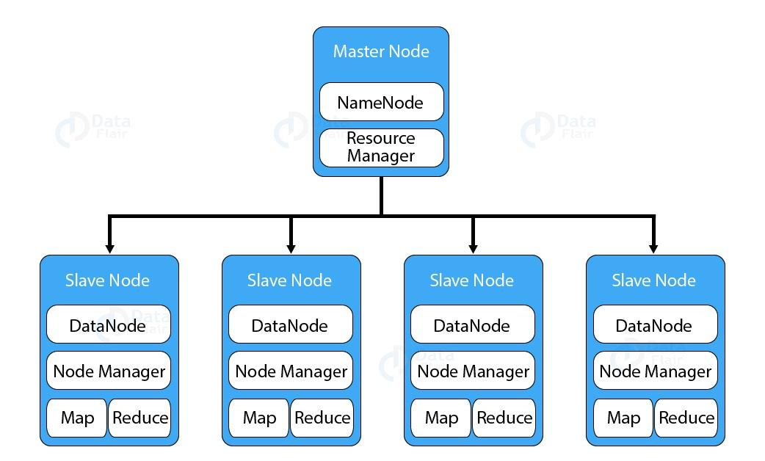
HDFS
HDFS stands for Hadoop Distributed File System. It provides for data storage of Hadoop. HDFS splits the data unit into smaller units called blocks and stores them in a distributed manner.
It has got two daemons running.
Master node – NameNode
Slave nodes – DataNode.

Slide 7
Master Nodes
NameNode
Only 1 per cluster
A single NameNode stores all metadata
Filenames, locations on DataNodes of each block, owner, group, etc.
All information maintained in RAM for fast lookup
File system metadata size is limited to the amount of available RAM on the NameNode

Slide 8
Slave Nodes
DataNode
1-4000 per cluster
Store file contents
Stores as opaque ‘blocks’ on the underlying file system
Different blocks of the same file will be stored on different DataNodes
Same blocks is stored on three (or more) DataNode for redundancy

Slide 9
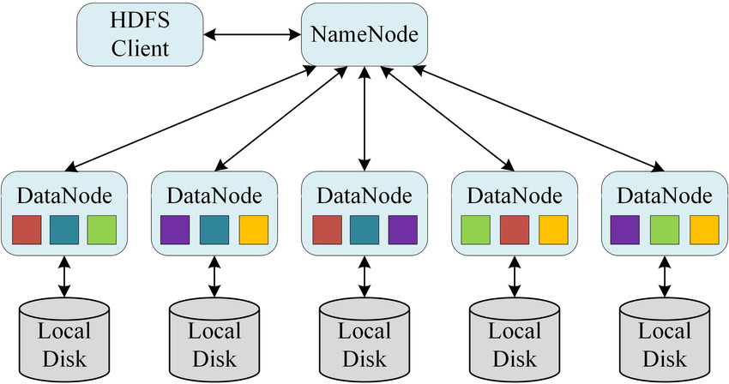
Self-healing
DataNodes send heartbeats to the NameNode
After a period without any heartbeats, a DataNode is assumed to be lost
NameNode determines which blocks were on the lost node
NameNode finds other DataNodes with copies of these blocks
These DataNodes are instructed to copy the blocks to other nodes
Replication is actively maintained
Same block stored in different DataNodes

Slide 10
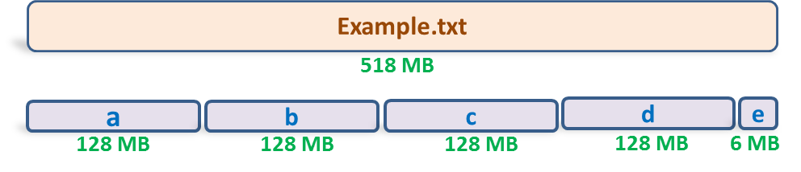
Block in HDFS
Block is nothing but the smallest unit of storage on a computer system. It is the smallest contiguous storage allocated to a file. In Hadoop, we have a default block size of 128MB or 256 MB.

Slide 11
What is MapReduce
MapReduce is a method for distributing a task across multiple nodes
Each node processes data stored on that node
Where possible
Consists of two phases:
Map
Reduce

Slide 12
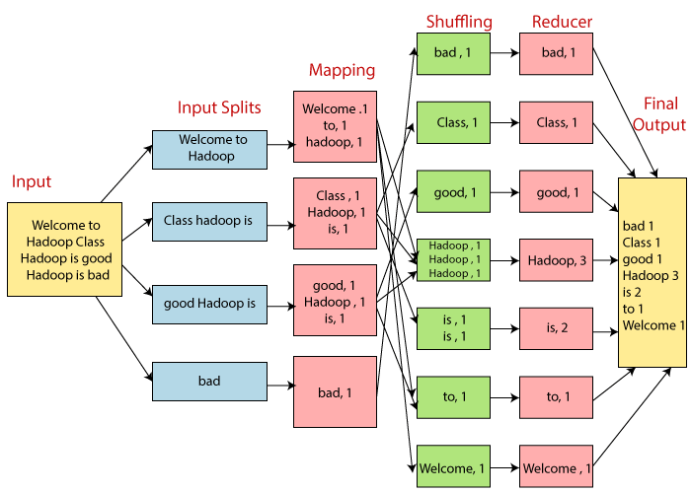
MapReduce
Map Task
RecordReader
Map
Combiner
Partitioner
Reduce Task
Shuffle and Sort
Reduce
OutputFormat

Slide 13
YARN
YARN or Yet Another Resource Negotiator is the resource management layer of Hadoop.
separate resource management and job scheduling/monitoring function into separate daemons
one global ResourceManager and per-application ApplicationMaster
Application can be a single job or a DAG of jobs
Inside the YARN framework, we have two daemons
ResourceManager
resources among all the competing applications in the system
NodeManager
monitor the resource usage by the container and report the same to ResourceManger

Slide 14
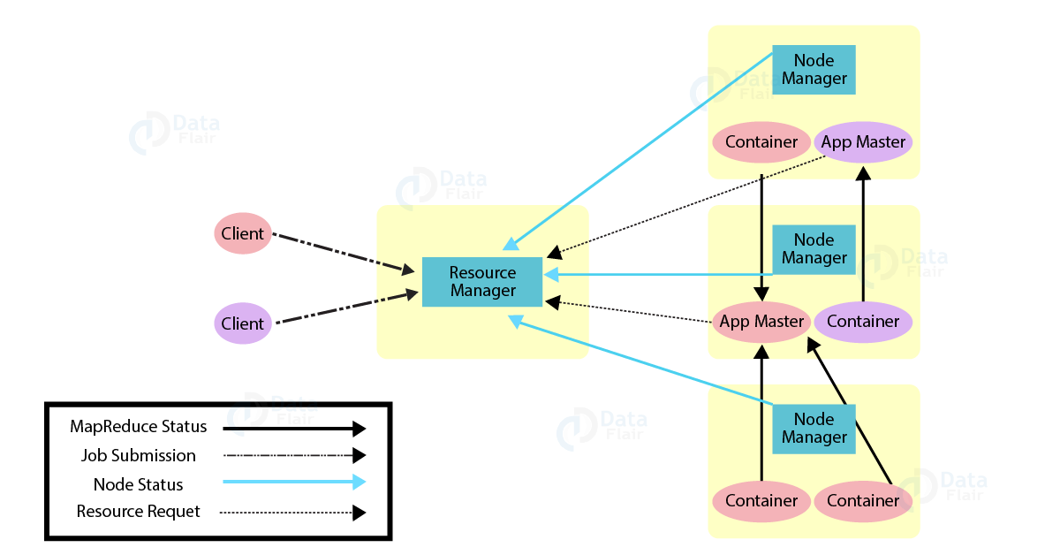
YARN

Slide 15
ResourceManger
The ResourceManger has two important components
Scheduler
ApplicationManager
Scheduler
Scheduler is responsible for allocating resources to various applications. This is a pure scheduler as it does not perform tracking of status for the application. It also does not reschedule the tasks which fail due to software or hardware errors. The scheduler allocates the resources based on the requirements of the applications.
Application Manager
Accepts job submission.
Negotiates the first container for executing ApplicationMaster. A container incorporates elements such as CPU, memory, disk, and network.
Restarts the ApplicationMaster container on failure.
Negotiates resource container from Scheduler.
Tracks the resource container status.
Monitors progress of the application.

Slide 16
Features of Yarn
Multi-tenancy
Cluster Utilization
Scalability
Compatibility

Slide 17
Reference
https://data-flair.training/blogs/hadoop-tutorial/Cluster Utilization
https://www.geeksforgeeks.org/hadoop-introduction/Compatibility

Slide 18
Thank You

